Slide 1
Interfacing Data Conversion

Slide 2
Data Conversion System
Data Conversion is the process of changing or converting one form of data in to another form. In processing and communication there are only two types of data forms i.e analog and digital data.
Real world signals are analog signals continuous time & amplitude (temp, pressure, position, sound, light, speed, etc.).
Digital processors can only process digital signals which are discrete time and discrete amplitude.

Slide 3
In order to interface digital processors with the analog world, data acquisition and reconstruction circuits must be used:
analog-to-digital converters (ADCs) to acquire and digitize the analog signal at the front end, and digital-to-analog converters (DACs) to reproduce the analog signal at the back end.
? Digital data conversion system requires ADC and DAC.

Slide 4
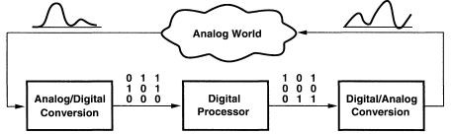

Slide 5
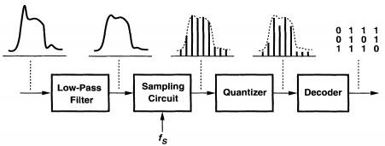
Analog-to-Digital Converter (ADC)
The analog-to-digital converter (ADC) converts a continuous-amplitude, continuous-time input to a discrete-amplitude, discrete-time signal.

Slide 6
An analog low-pass (anti-alias) filter limits the input signal bandwidth so that subsequent sampling does not alias any unwanted noise or signal components into the actual signal band.
The filter output signal is sampled at a rate of f_{S} samples per second to produce a discrete-time signal.
The amplitude of this discrete-time signal is "quantized," i.e., approximated with a level from a set of fixed references, thus generating a discrete-amplitude signal.
The discrete-amplitude signal is decoded to a digital representation of that level is established at the output.

Slide 7
ADC Applications
ADC are used virtually everywhere an analog signal has to be processed, stored, pr transported in digital form
Microphones
Strain Gages
Thermocouple
Voltmeters
Digital Multimeters

Slide 8
A/D Converter Types
Flash ADC
Delta-Sigma ADC
Dual Slope (integrating) ADC
Successive Approximation ADC

Slide 9
Flash ADC
Flash ADC is fastest among all ADC
It takes only one clock cycle to have conversion
Consists of a series of comparators, each one comparing the input signal to a unique reference voltage.
The comparator outputs connect to the inputs of a priority encoder circuit, which produces a binary output

Slide 10
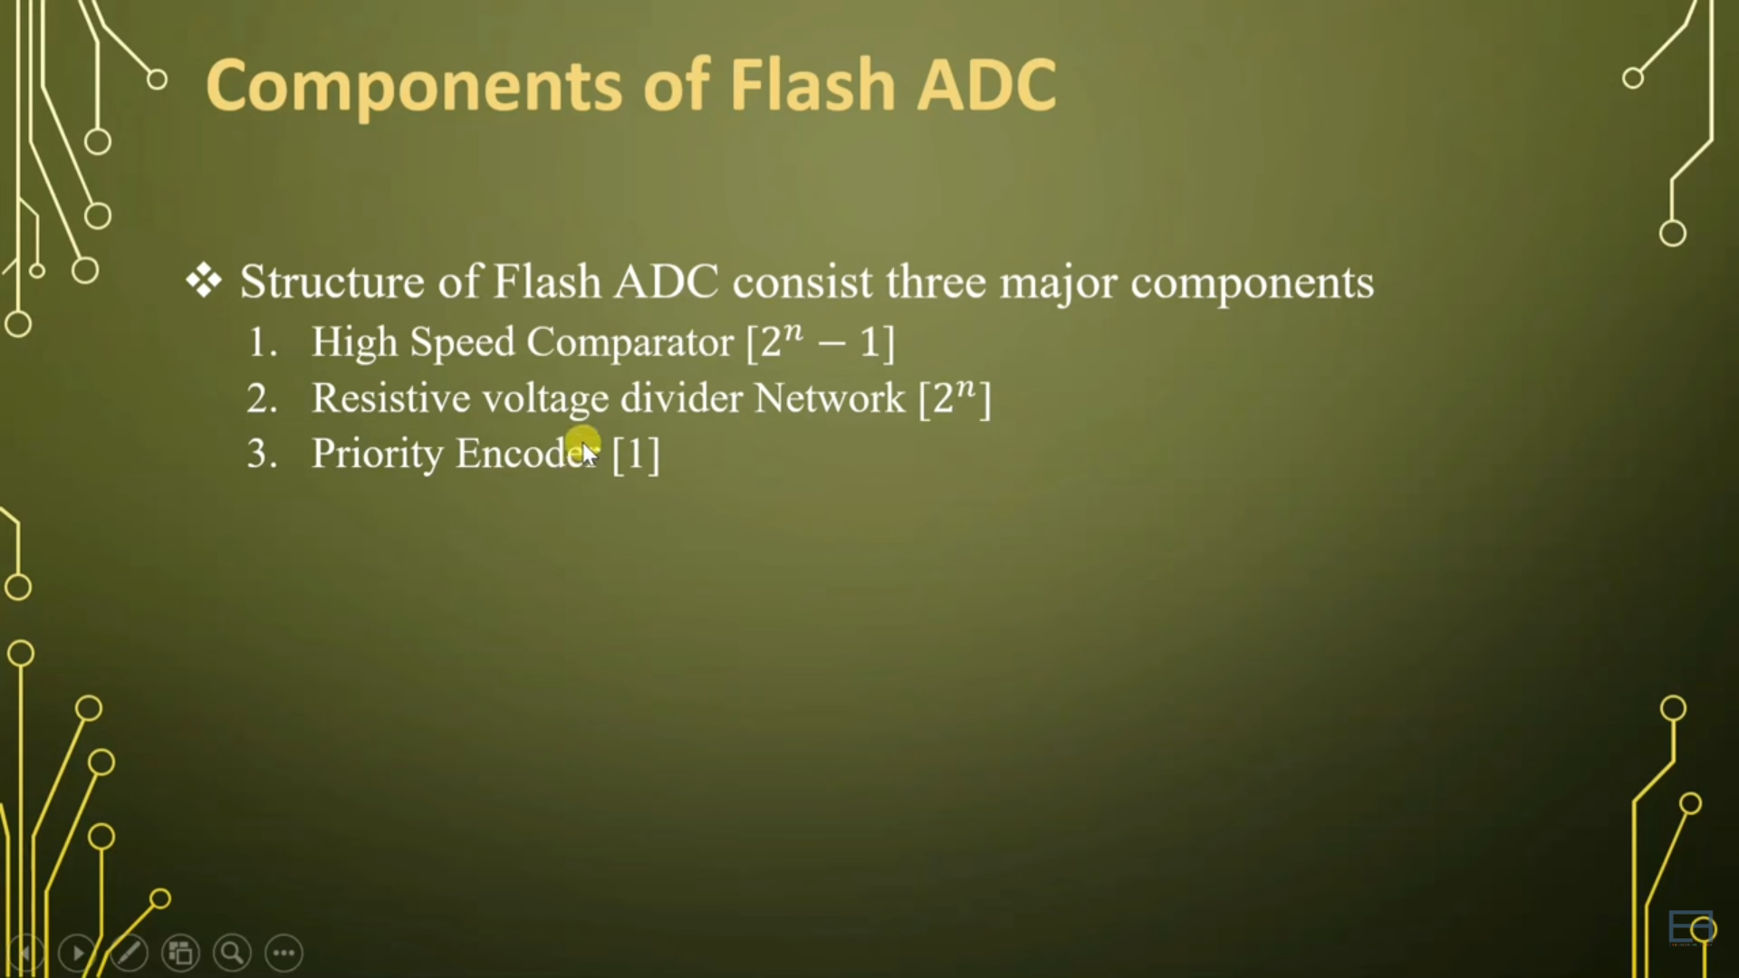

Slide 11
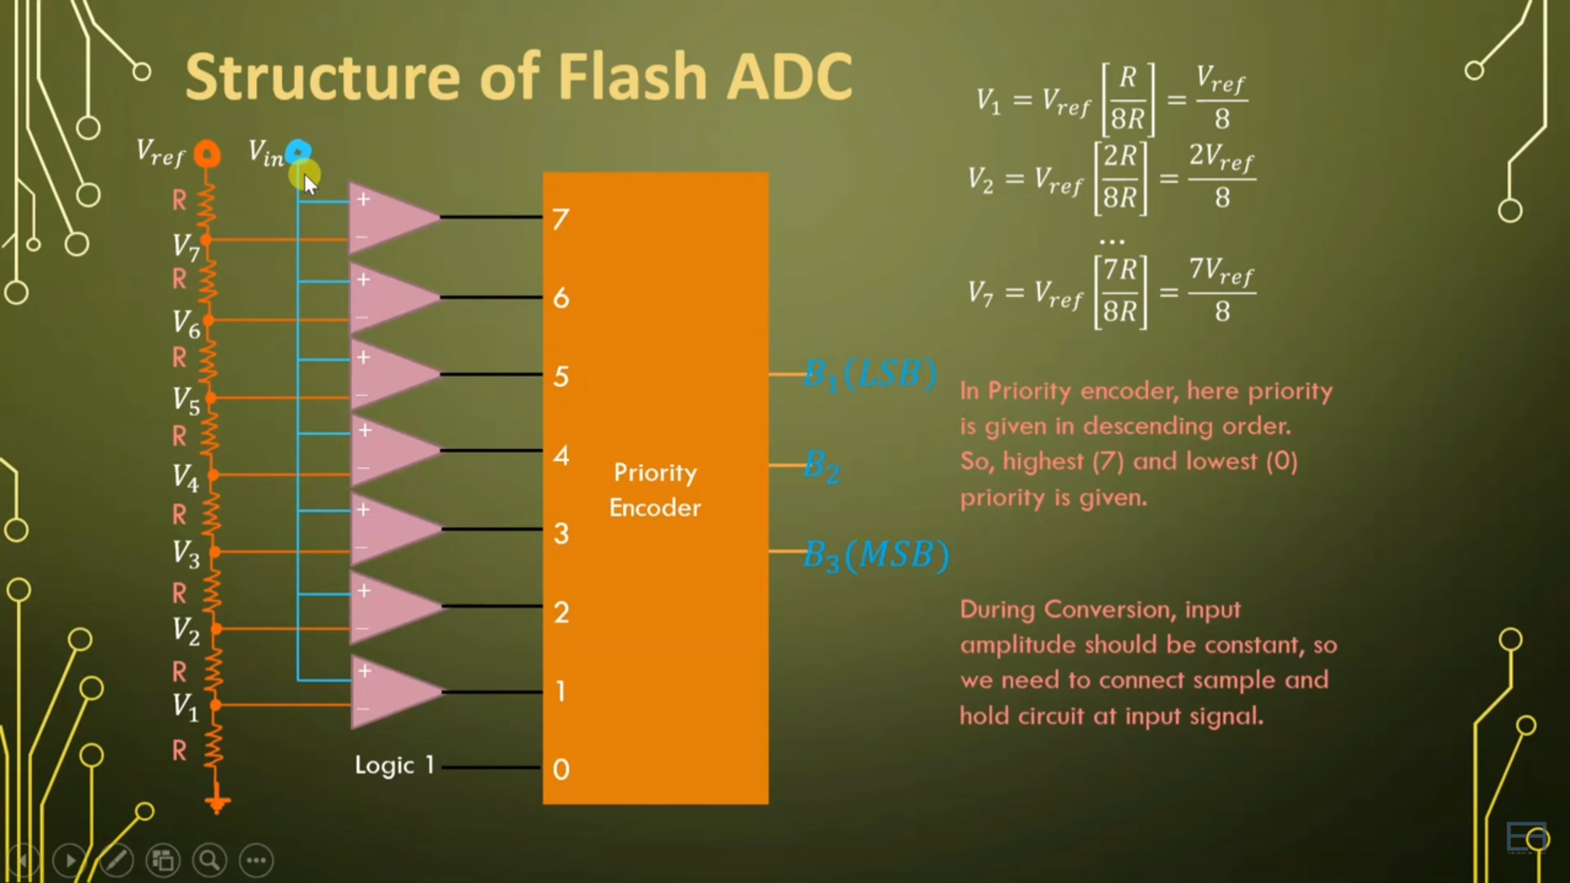

Slide 12
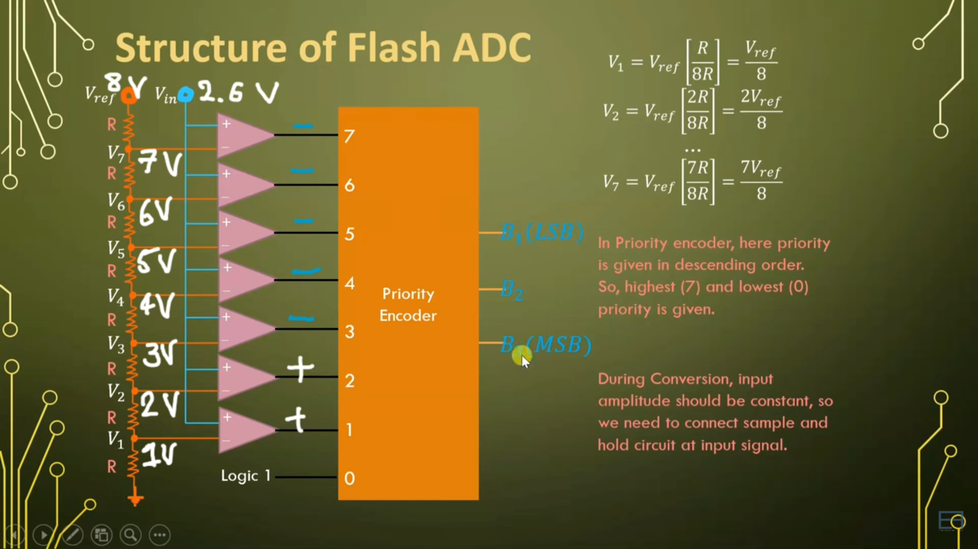
Working of Flash ADC

Slide 13
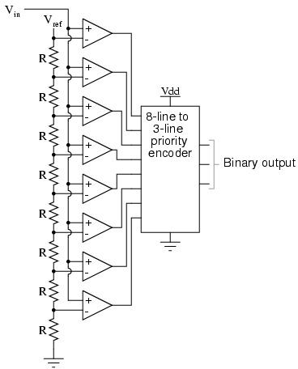
Flash ADC Circuit

Slide 14
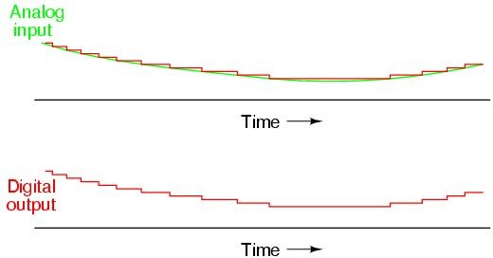
ADC Output

Slide 15
Flash
Advantages
Simplest in terms of operational theory
Useful with large bandwidth
Most efficient in terms of speed, very fast (Giga samples per second)
limited only in terms of comparator and gate propagation delays
Disadvantages
Lower resolution (Up to 8 bits)
Expensive
High power consumption because For each additional output bit, the number of comparators is doubled i.e. for 8 bits, 256 comparators needed

Slide 16
Applications of Flash ADC
Satellite Communication
RADAR processing
Oscilloscope

Slide 17
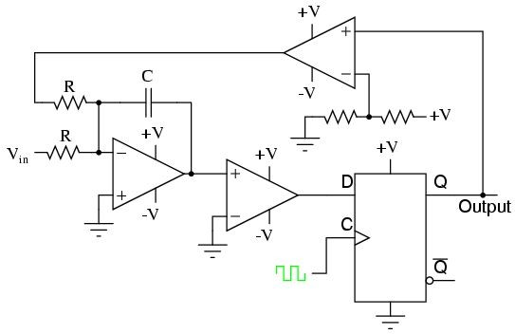
Sigma Delta ADC
Over sampled input signal goes to the integrator
Output of integration is compared to GND
Iterates to produce a serial bit stream
Output is serial bit stream with # of 1’s proportional to V_{in}

Slide 18
Sigma-Delta
Advantages Disadvantages
High resolution • Slow due to oversampling
No precision external components needed

Slide 19





Dual Slope Converter
The sampled signal charges a capacitor for a fixed amount of time
By integrating over time, noise integrates out of the conversion
Then the ADC discharges the capacitor at a fixed rate with the counter counts the ADC’s output bits. A longer discharge time results in a higher count
^{V}in
^{t}FIX ^{t}meas
t

Slide 20
Dual Slope Converter
Advantages
Input signal is averaged
Greater noise immunity than other ADC types
High accuracy
Disadvantages
Slow
High precision external components required to achieve accuracy

Slide 21
Successive Approximation ADC
A Successive Approximation Register (SAR) is added to the circuit
Instead of counting up in binary sequence, this register counts by trying all values of bits starting with the MSB and finishing at the LSB.
The register monitors the comparators output to see if the binary count is greater or less than the analog signal input and adjusts the bits accordingly

Slide 22
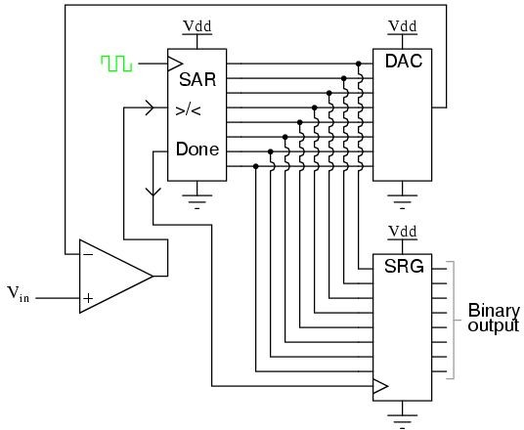
Successive Approximation ADC Circuit

Slide 23
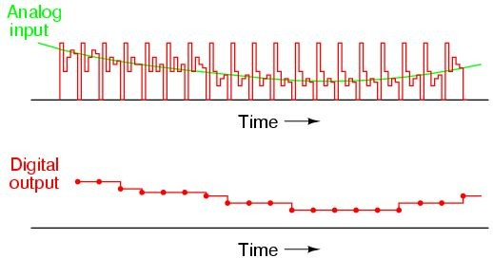
ADC Output

Slide 24
Successive Approximation
Advantages
Capable of high speed and reliable
Medium accuracy compared to other ADC types
Good tradeoff between speed and cost
Capable of outputting the binary number in serial (one bit at a time) format.
Disadvantages
Higher resolution successive approximation ADC’s will be slower
Speed limited to ~5Msps

Slide 25
ADC Types Comparison
Type | Speed (relative) | Cost (relative)
Dual Slope | Slow | Med
Flash | Very Fast | High
Successive Appox | Medium – Fast | Low
Sigma-Delta | Slow | Low

Slide 26
AD570
The AD570 is an 8-bit successive approximation A/D converter consisting of a DAC, voltage reference, clock, comparator, successive approximation register and output buffers---all fabricated on a single chip.
The AD570 incorporates the most advanced integrated circuit design and processing technology available today.

Slide 27
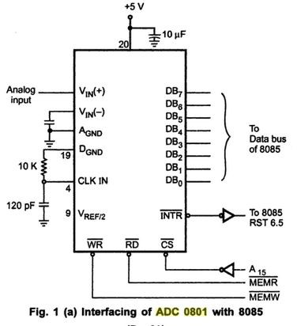
ADC 0801
The ADC 0801
is a 8-bit successive-appr oximation A/D converter.

Slide 28
Digital-to-Analog Converter (DAC)
The digital data is processed by a digital processor and output to the digital-to analog converter (DAC).
The DAC reverses the ADC process, it converts a discrete time, discrete amplitude into continuous time, continuous amplitude. The DAC is usually operated at same frequency as the ADC.

Slide 29
A DAC selects and produces an analog level from a set of fixed references according to the digital input.
If the DAC generates large glitches during switching from one code to another, a "deglitching" circuit (usually a sample-and-hold amplifier) follows to mask the glitches.
The reconstruction function performed by the DAC introduces sharp edges in the waveform as well as a sine envelope in the frequency domain, an inverse-sine filter and a low-pass filter are required to suppress these effects. The resulting staircase-like signal is finally passed through a smoothing filter to ease the effects of quantization noise.

Slide 30
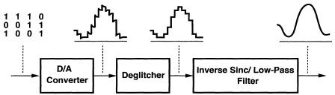

Slide 31
DAC Applications
Digital Motor Control
Computer Printers
Sound Equipment (e.g. CD/MP3 Players, etc.)
Electronic Cruise Control
Digital Thermostat

Slide 32
D/A Converter Types
Many types of DACs available.
Usually switches, resistors, and op-amps used to implement conversion
Two Types:
Binary Weighted Resistor
R-2R Ladder

Slide 33
Binary Weighted Resistor
Utilizes a summing op-amp circuit
Weighted resistors are used to distinguish each bit from the most significant to the least significant
Transistors are used to switch between V and ground (bit high or low)
ref

Slide 34








Binary Weighted Resistor (Cont.)
Assume Ideal Op-amp
No current into op-amp
Virtual ground at inverting input
^{V}ref
R
2R
4R
I
Rf
V_{out}= -IR
f
-
V
out
+
2^{n}R

Slide 35
Binary Weighted Resistor (Cont.)
Advantages
Simple Construction/Analysis
Fast Conversion
Disadvantages
Requires large range of resistors (2000:1 for 12-bit DAC) with necessary high precision for low resistors
Requires low switch resistances in transistors
Can be expensive. Therefore, usually limited to 8-bit resolution.

Slide 36
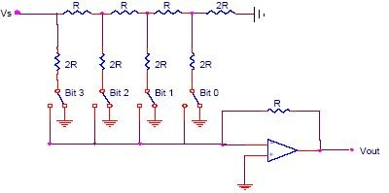
R-2R Ladder
Each bit corresponds to a switch:
^{V}ref
If the bit is high, the corresponding
switch is connected to the inverting input of the op-amp.
If the bit is low, the corresponding switch is connected to ground.
Bit: 0
0 0 0
4-Bit Converter
V
out

Slide 37
R-2R Ladder (Cont.)
Advantages
Only two resistor values (R and 2R)
Does not require high precision resistors
Disadvantage
Lower conversion speed than binary weighted DAC

Slide 38
AD 7522
The AD 7522 is a systems-compatible 10-bit multiplying D/A converter, fabricated on a single 3 x 2.2mm (118 x 89 mil) silicon die, and packaged in a 28-pin plastic or ceramic dual
in-line package.

Slide 39
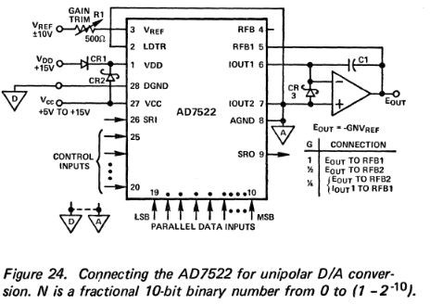

Slide 40
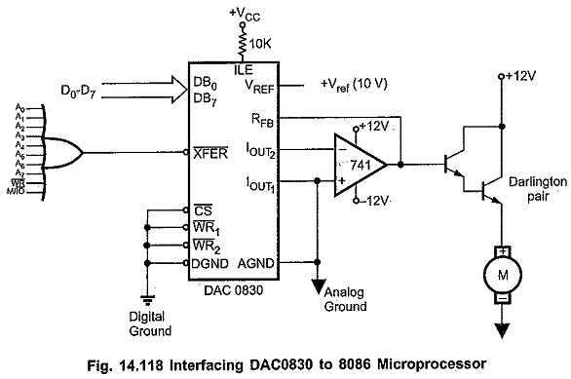
Interfacing DAC 0830 with 8086:
The DAC0830 Digital to Analog Converter is connected to 8086 microprocessor, as shown in the Fig. 14.118. Here, I/O port address is decoded using_ OR gate. The digital data is loaded into DAC0830 when A₀-A₇ lines, WR and IO/M signals are low. This gives us the address for DAC0830 as 00H and the data can be loaded in the DAC0830 by OUT 00H,AL instruction, where AL register contains the digital data to be sent to DAC0830. The IC 741, the operational amplifier is used to convert current output of DAC0830 to voltage output. The voltage output of the operational amplifier is used to drive the DC motor after increasing the driving capacity. The driving capacity is increased by using the darlington transistor.

